Slide 1
Continuous Random Variable

Slide 2

X is a continuous† random variable if there exists a nonnegative function f , defined for all real x ∈ (−q,q), having the property that, for any set B of real numbers,
The function f is called the probability density function of the random variable X.

Slide 3


the probability that X will be in B may be obtained by integrating the probability density function over the set B. Since X must assume some value, f must satisfy
letting B = [a, b], we obtain

Slide 4
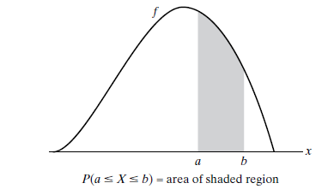
Probability density function f

Slide 5


If we let a = b, we get
In words, this equation states that the probability that a continuous random variable will assume any fixed value is zero. Hence, for a continuous random variable,

Slide 6

Suppose that X is a continuous random variable whose probability density function is given by
(a) What is the value of C?
(b) Find P{X > 1}.

Slide 7



EXPECTATION AND VARIANCE OF CONTINUOUS RANDOM VARIABLES

Slide 8


THE UNIFORM RANDOM VARIABLE
A random variable is said to be uniformly distributed over the interval (0, 1) if its probability density function is given by

Slide 9

NORMAL RANDOM VARIABLES
We say that X is a normal random variable, or simply that X is normally distributed, with parameters μ and σ2 if the density of X is given by
This density function is a bell-shaped curve that is symmetric about μ.

Slide 10
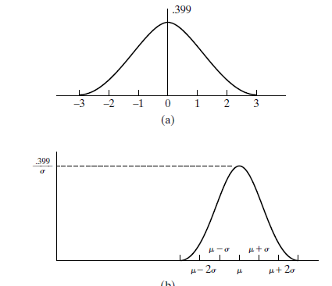
Normal density function: (a) μ = 0, σ = 1; (b) arbitrary μ, σ2

Slide 11
Some examples of random phenomena obeying this behavior are the
height of a man
velocity in any direction of a molecule in gas, and
the error made in measuring a physical quantity.

Slide 12
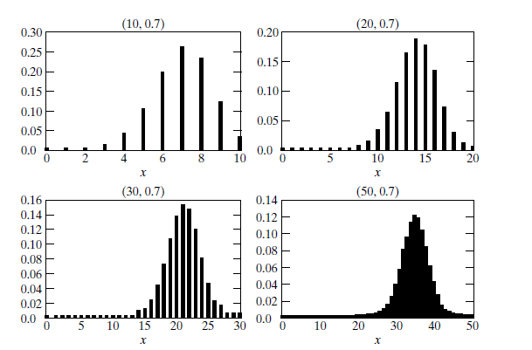
PMF of a binomial (n,p)

